Slide 1
Credit Card Analysis Report
By : Atharva Subhash Patkar

Slide 2
Contents:
The project objective
Credit card transaction report
Credit card customer report
The project insights

Slide 3
Credit Card Analysis Report
Objectives:
Develop a interactive credit card weekly dashboard for real-time insights into key performance metrics and trends in credit card operations.

Slide 4
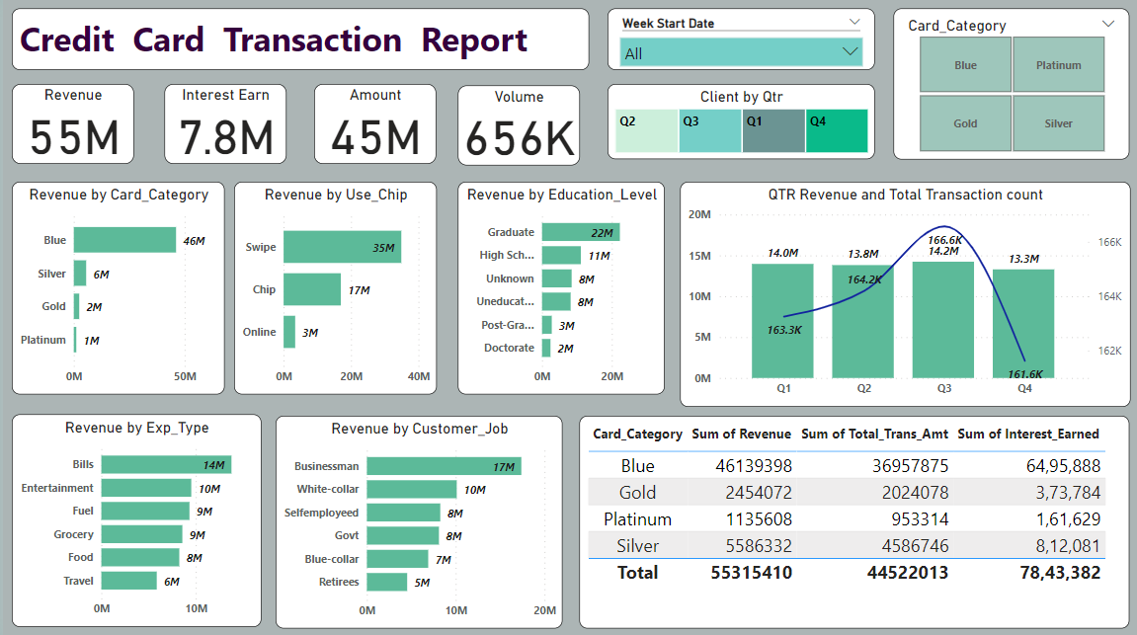

Slide 5
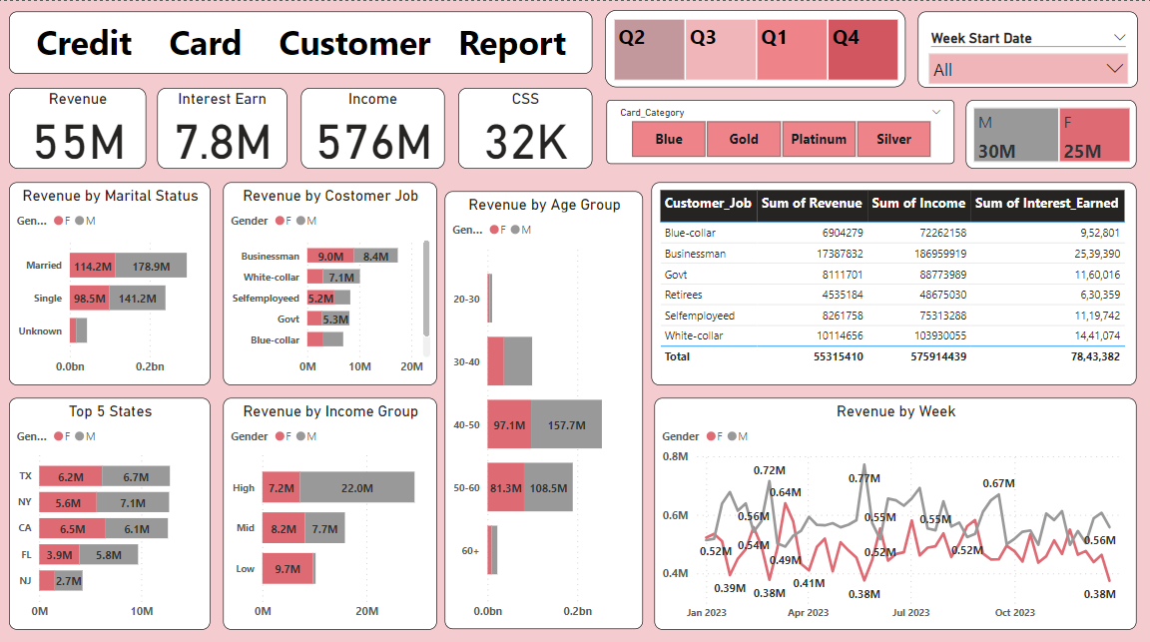

Slide 6
Credit Card Analysis Report
Data Preparations and processing consists:
CSV files prepared, MYSQL tables created and data imported into SQL for Power BI integrations.
Connected Power BI to database.
Insights of analysis:
Week-on-week revenue increased by 28.8%.
Total revenue 57M with interest 7.8M and total transaction of 45M.
Male customers of count 30M with age group of 40 to 60 contributed more than female with count of 25M.
TX,NY and CA are the most contributed states with overall contribution of 93%.
Blue and silver credit cards accounted for 88% of transaction.
Delinquency rate :6.07 %

